Slide 1
Data Mining: Concepts and Techniques Mining Frequent Patterns, Association and Correlations
*
1

Slide 2
Frequent Patterns(itemsets/subsequences)
Finding the frequent patterns plays an essential role in mining associations, correlations and some other type of interesting relationships among the data.
Moreover, it helps in classification,clustering and other data mining tasks.
*
2

Slide 3
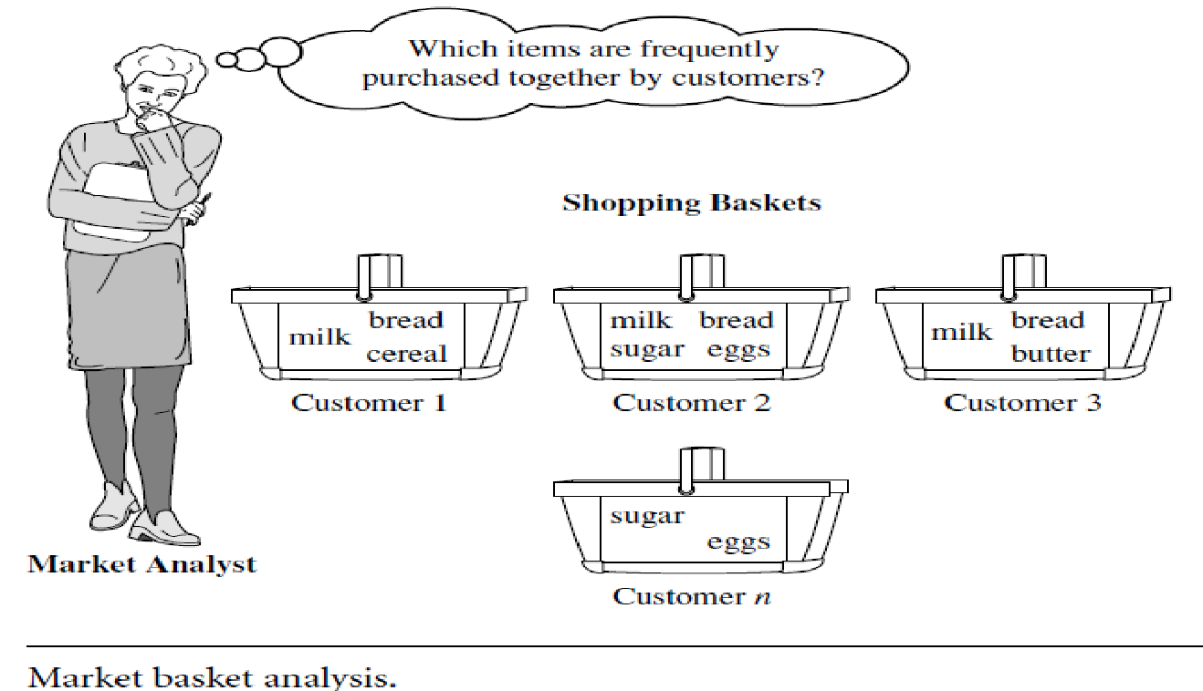
Frequent Itemset Mining:Market Basket Analysis
Frequent itemset mining leads to the discovery of associations and correlations among items in large transactional or relational data sets.
MBA is the process of analyzing the buying habits of customers by finding the associations between the different items that the customers place in their basket.
The results of MBA can be used :
To plan Marketing strategies.
To plan Advertising strategies.
To develop new designs (e.g Store layout designs)
It help retailers to plan which items to put on sale at reduced prices.
*
3

Slide 4
Frequent Itemset Mining:Market Basket Analysis
Frequent patterns can be represented in the form of association rules.
Rule support and confidence are two measures of rule interestingness.
They respectively reflect the usefulness and certainty of discovered rules.
A support of 2% for Rule means that 2% of all the transactions under analysis show that computer and antivirus software are purchased together.
A confidence of 60% means that 60% of the customers who purchased a computer also bought the antivirus software.
Typically, association rules are considered interesting if they satisfy both a minimum support threshold and a minimum confidence threshold.
*
4

Slide 5
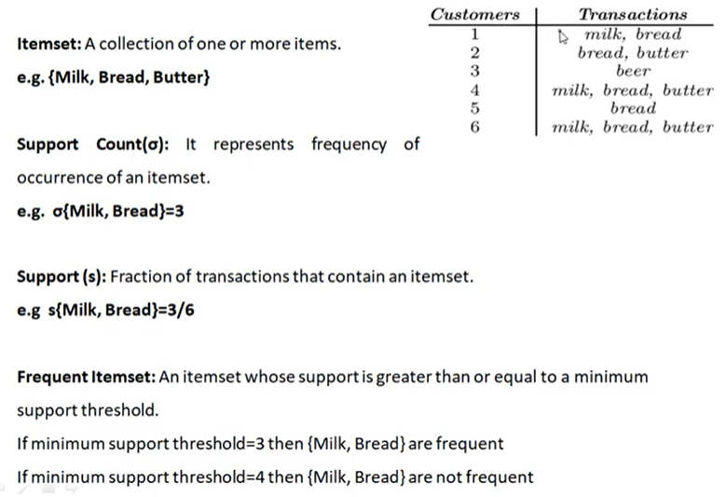


Basic Terms of Association Rule Mining
Absolute support
Relative support

Slide 6
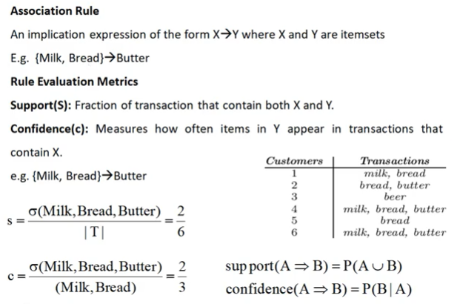
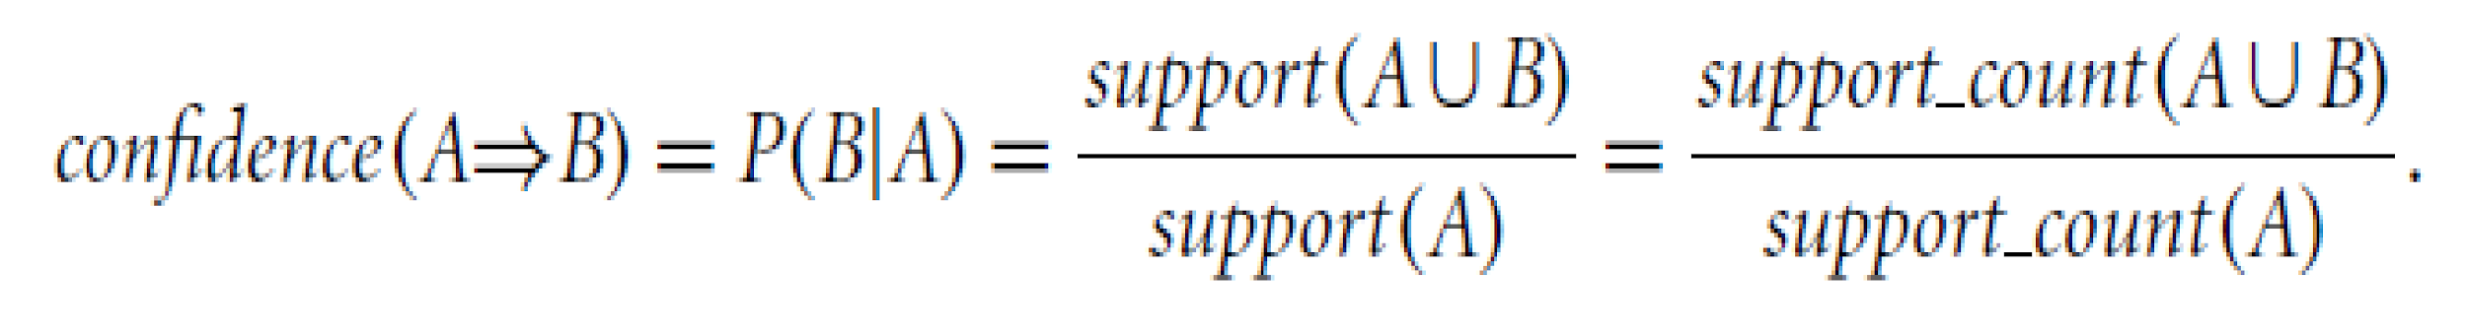







Support and confidence
Rules that satisfy both a minimum support threshold (min sup) and a minimum confidence threshold (min conf ) are called strong.

Slide 7
Support and Confidence
For association rule A => B,
Support (s)= σ(A U B) / |T|
Confidence (c) = σ(A U B) / σ(A)

Slide 8
Association Rule Mining steps
In general, association rule mining can be viewed as a two-step process:
1. Find all frequent itemsets: By definition, each of these itemsets will occur at least as frequently as a predetermined minimum support count, min sup.
2. Generate strong association rules from the frequent itemsets: By definition, these rules must satisfy minimum support and minimum confidence.

Slide 9
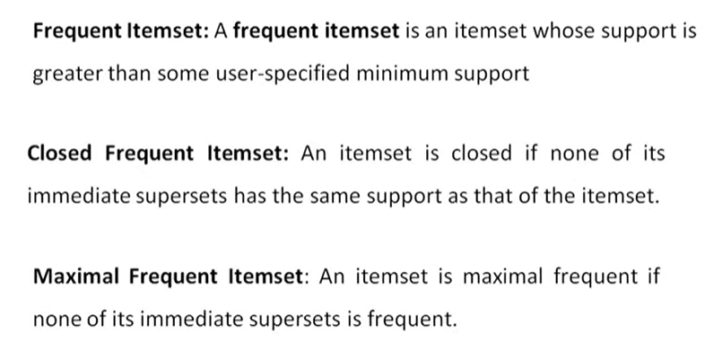
Frequent Itemset,Closed Itemset and Maximal Frequent Itemset

Slide 10
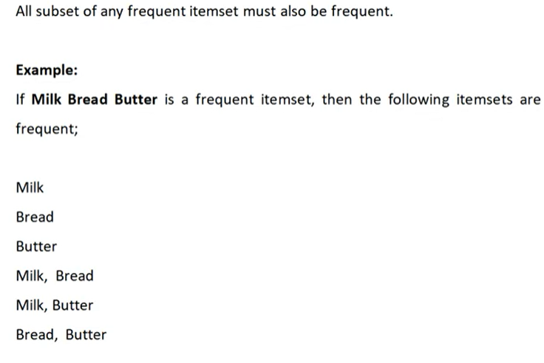
Downward Closure Property of Frequent Patterns

Slide 11
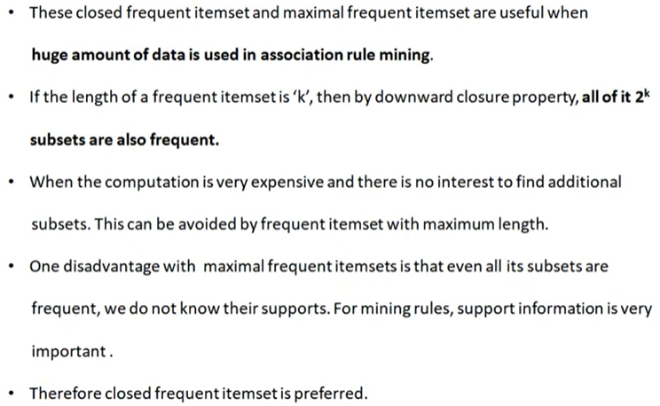
Need of Closed and Maximal Itemset

Slide 12
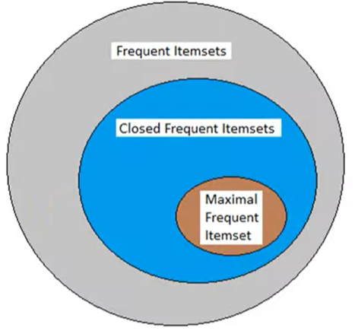

Slide 13
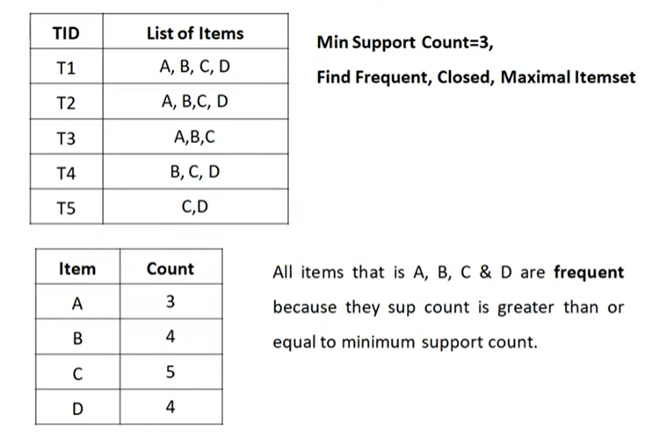



Example: Frequent Itemset,Closed Itemset and Maximal Frequent Itemset

Slide 14
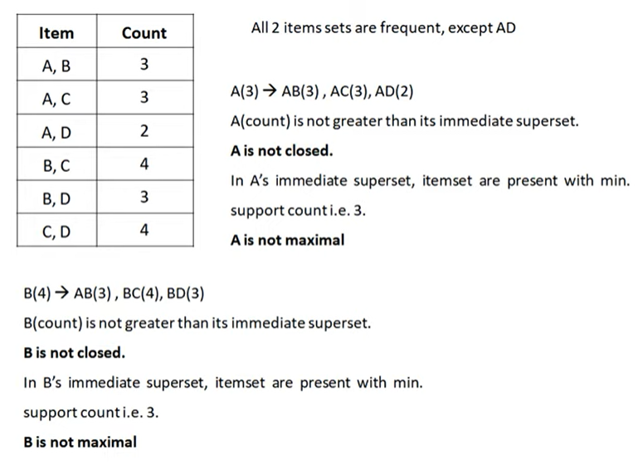
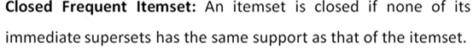
Example: Frequent Itemset,Closed Itemset and Maximal Frequent Itemset
2-itemsets

Slide 15
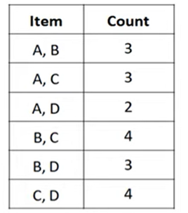
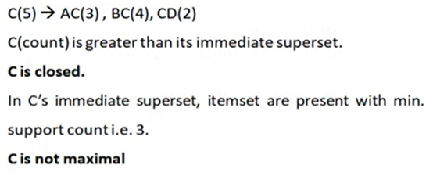
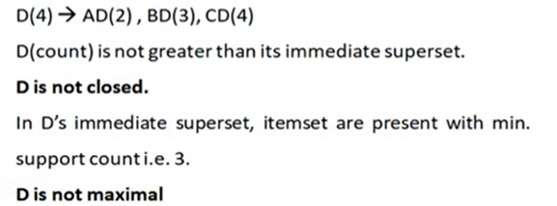



Example: Frequent Itemset,Closed Itemset and Maximal Frequent Itemset
2-itemsets
Is C closed,Maximal?
Is D closed,Maximal?

Slide 16
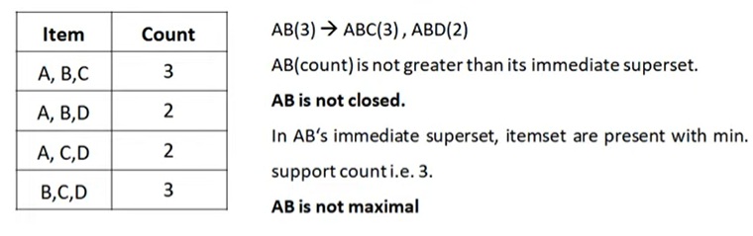
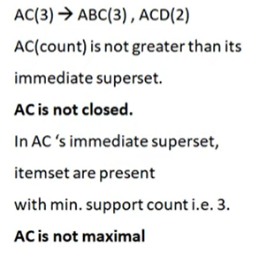
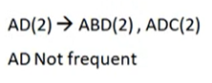
Example: Frequent Itemset,Closed Itemset and Maximal Frequent Itemset
3-Itemsets
Is AB closed,Maximal?
Is AC closed,Maximal?
Is AD frequent?

Slide 17
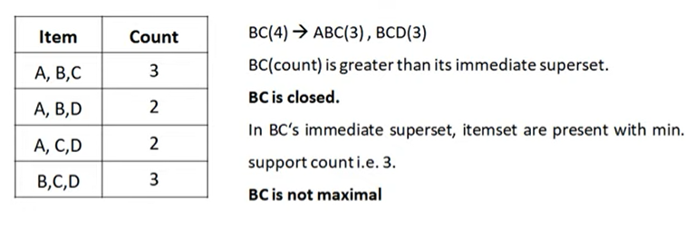
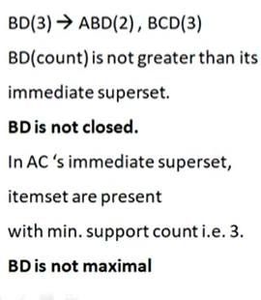
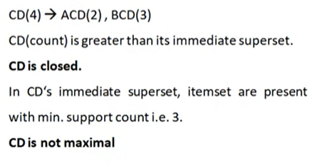
Example: Frequent Itemset,Closed Itemset and Maximal Frequent Itemset

Slide 18
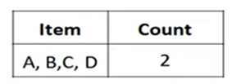
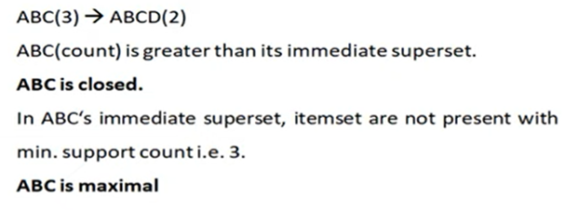
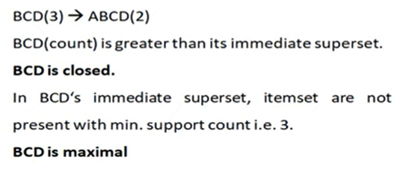
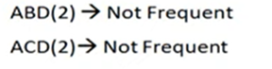
Example: Frequent Itemset,Closed Itemset and Maximal Frequent Itemset
4-Itemsets
Is ABC closed,Maximal?
What about ABCD?
ABCD is not frequent
Is BCD closed,Maximal?

Slide 19
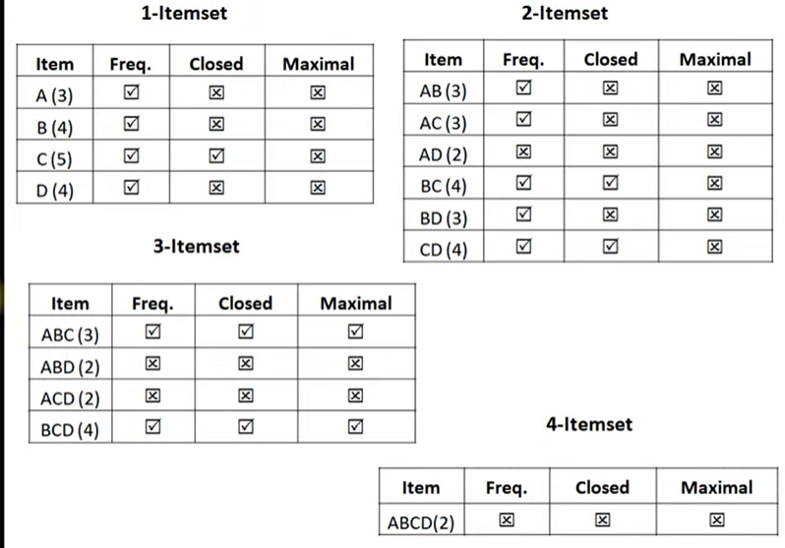



Slide 20
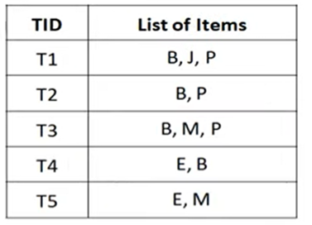
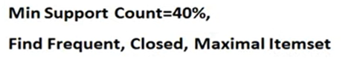
Example

Slide 21
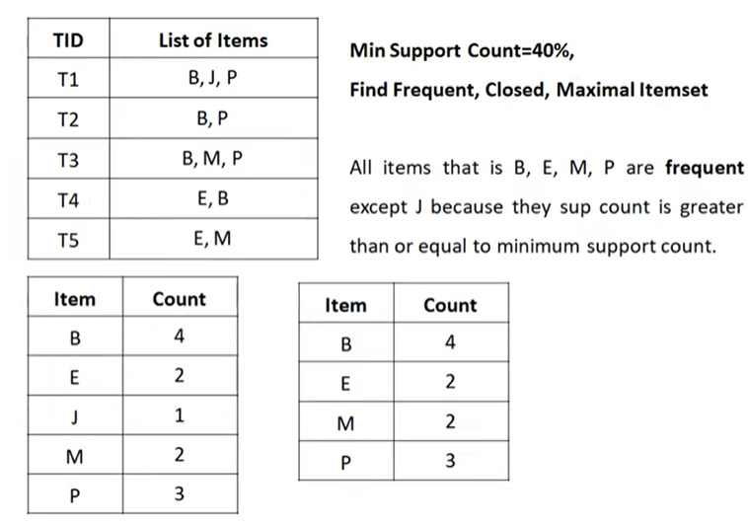
Example
Frequent 1-itemsets
Frequent 1-itemsets

Slide 22
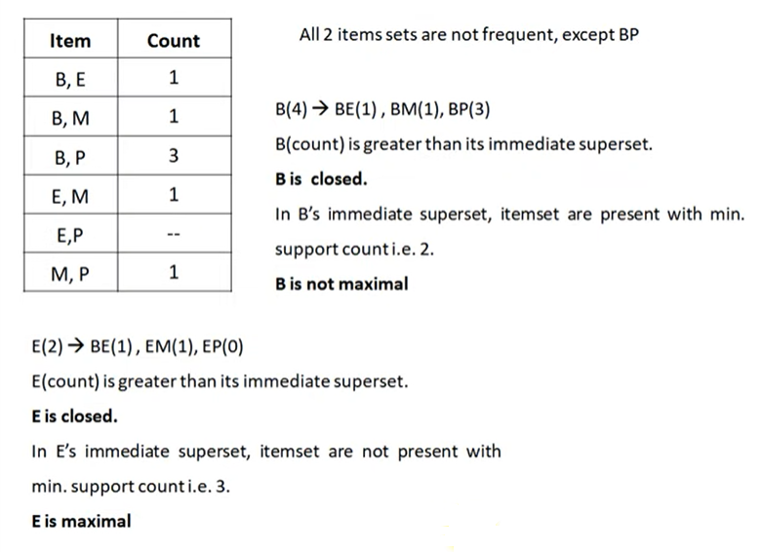
Frequent 2-itemsets

Slide 23
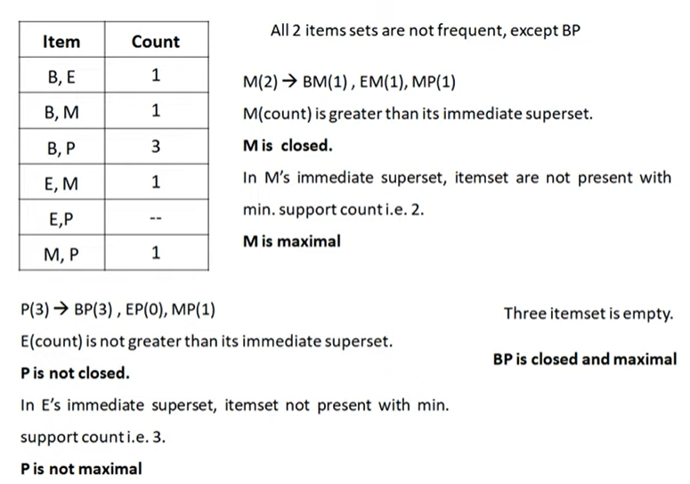

Slide 24
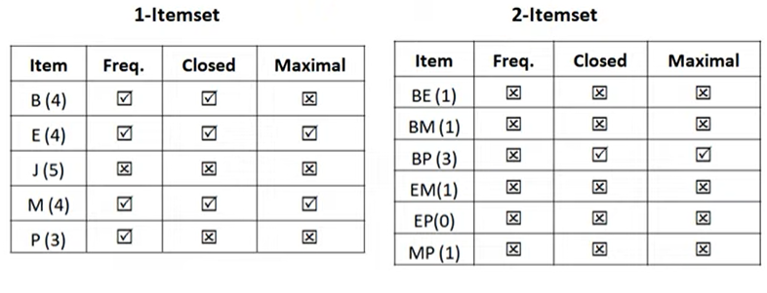

Slide 25
Frequent Itemset Mining Methods: Apriori Algorithm: Finding Frequent Itemsets by Confined Candidate Generation
The algorithm uses prior knowledge of frequent itemset properties.
Apriori employs an iterative approach known as a level-wise search, where k-itemsets are used to explore (k+1) - itemsets.
First, the set of frequent 1-itemsets is found by scanning the database to accumulate the count for each item, and collecting those items that satisfy minimum support. The resulting set is denoted by L1.
Next, L1 is used to find L2, the set of frequent 2-itemsets, which is used to find L3, and so on, until no more frequent k-itemsets can be found.
The finding of each L_{k} requires one full scan of the database.
To improve the efficiency of the level-wise generation of frequent itemsets, an
Apriori property (Any subset of frequent itemset must be frequent) is used to reduce the search space.
*
25

Slide 26

“How is the Apriori property used in the algorithm?”
How L_{k-1} is used to find L_{k} for k= 2?
Join Step: To find L_{k}, a set of candidate k-itemsets is generated by joining L_{k-1} with itself. This set of candidates is denoted as C_{k}.
The join, L_{k-1} ⋈ L_{k-1}, is performed, where members of L_{k-1} are joinable if their first (k -2) items are in common.
2. The prune step: Select only frequent itemsets
Apriori pruning principle: If there is any itemset which is infrequent, its superset should not be generated/tested!

Slide 27
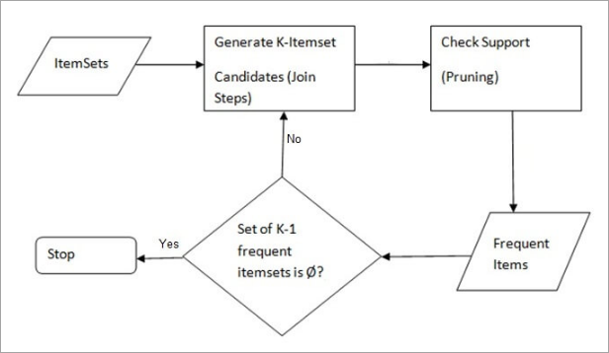








Apriori Algorithm Process

Slide 28
Apriori: A Candidate Generation-and-Test Approach
Apriori pruning principle: If there is any itemset which is infrequent, its superset should not be generated/tested!
Method:
Initially, scan DB once to get frequent 1-itemset
Generate length (k+1) candidate itemsets from length k frequent itemsets
Test the candidates against DB
Terminate when no frequent or candidate set can be generated
*
Data Mining: Concepts and Techniques
28

Slide 29
The Apriori Algorithm
Pseudo-code:
C_{k}: Candidate itemset of size k
L_{k} : frequent itemset of size k
L₁ = {frequent items};
for (k = 1; L_{k} !=∅; k++) do begin
C_{k+1} = candidates generated from L_{k ;}
for each transaction t in database do
increment the count of all candidates in C_{k+1} that are contained in t
L_{k+1} = candidates in C_{k+1} with min_support
end
return ∪_{k} L_{k} ;
*
Data Mining: Concepts and Techniques
29

Slide 30










The Apriori Algorithm—An Example
Sup_{min} = 2
Itemset | sup
{A} | 2
{B} | 3
{C} | 3
{D} | 1
{E} | 3
Database TDB
Itemset | sup
{A} | 2
{B} | 3
{C} | 3
{E} | 3
L₁
C₁
Tid | Items
10 | A, C, D
20 | B, C, E
30 | A, B, C, E
40 | B, E
1st scan
C₂
Itemset | sup
{A, B} | 1
{A, C} | 2
{A, E} | 1
{B, C} | 2
{B, E} | 3
{C, E} | 2
C₂
Itemset
{A, B}
{A, C}
{A, E}
{B, C}
{B, E}
{C, E}
L₂
Itemset | sup
{A, C} | 2
{B, C} | 2
{B, E} | 3
{C, E} | 2
2nd scan
C₃
Itemset
{B, C, E}
3rd scan
L₃
Itemset | sup
{B, C, E} | 2
C: Candidate Itemset
L: Frequent Itemset
*
Data Mining: Concepts and Techniques
30

Slide 31
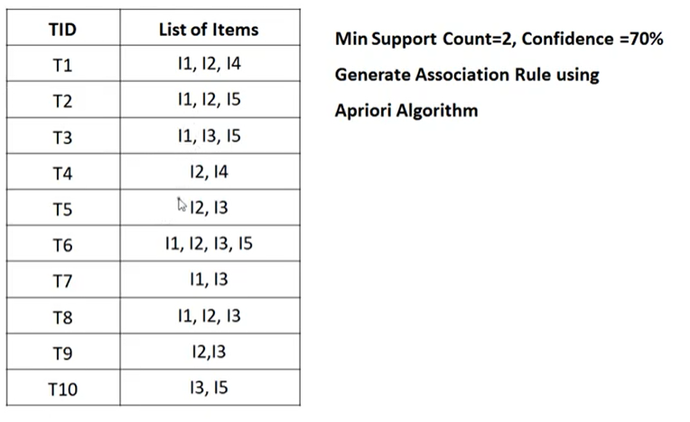

Example:Apriori Algorithm

Slide 32
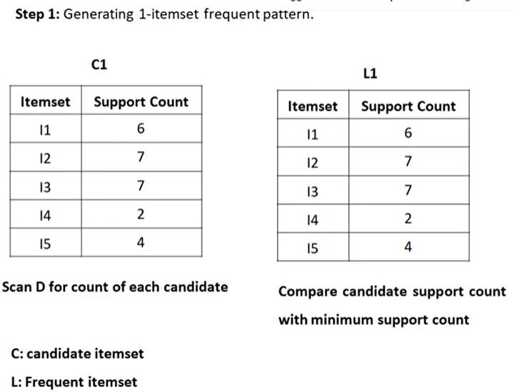
Example:Apriori Algorithm

Slide 33
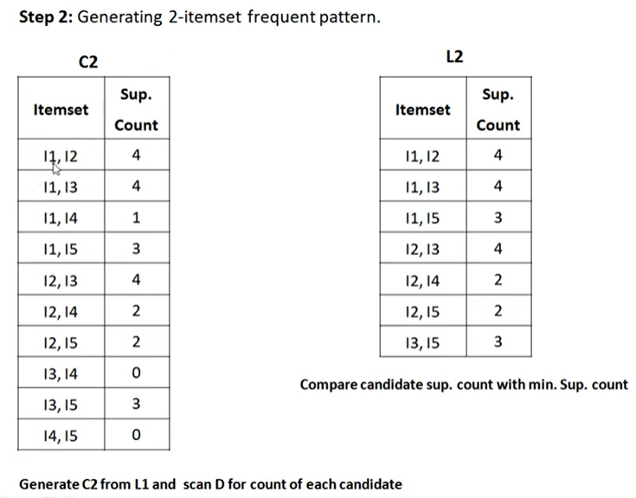
Example:Apriori Algorithm

Slide 34
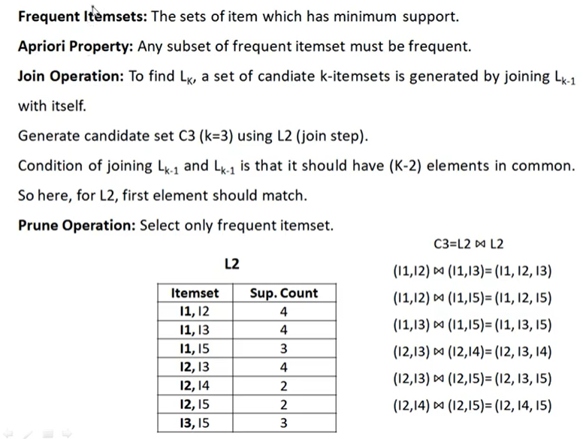
Example:Apriori Algorithm

Slide 35
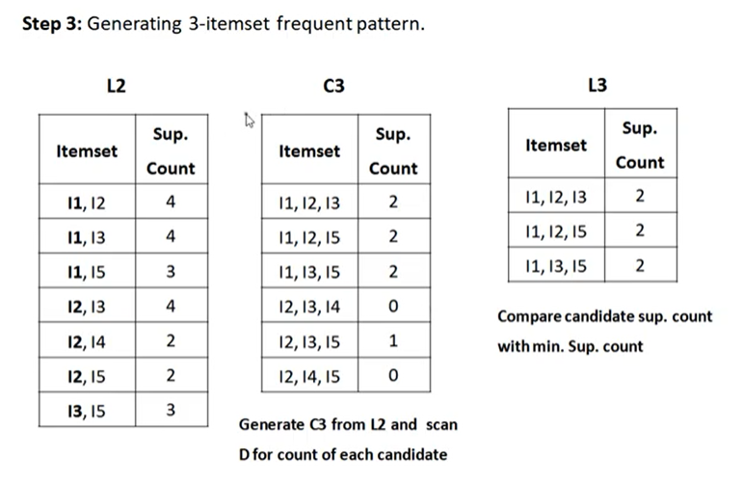









Example:Apriori Algorithm

Slide 36
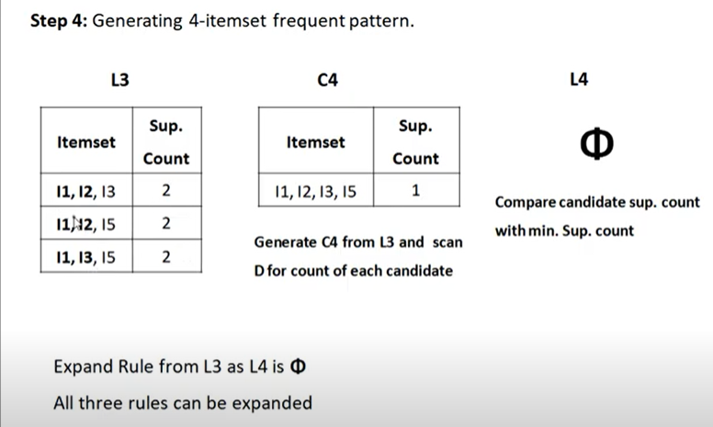
Example:Apriori Algorithm

Slide 37
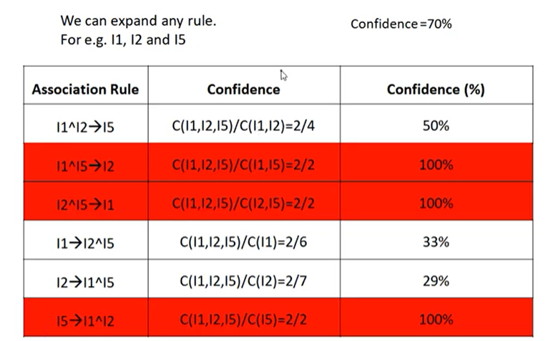
Example:Apriori Algorithm
If the minimum confidence threshold is, say, 70%, then only the second, third, and last rules are output, because these are the only ones generated that are strong.

Slide 38
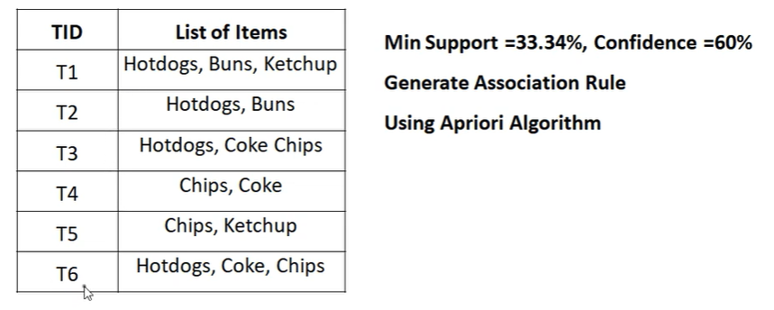
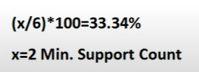






Exercise

Slide 39
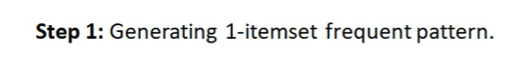
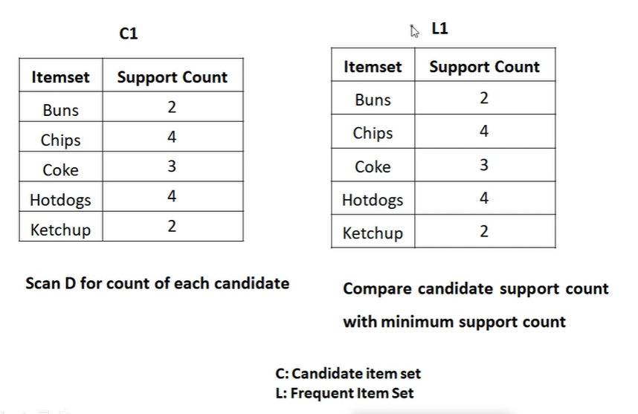

Exercise

Slide 40
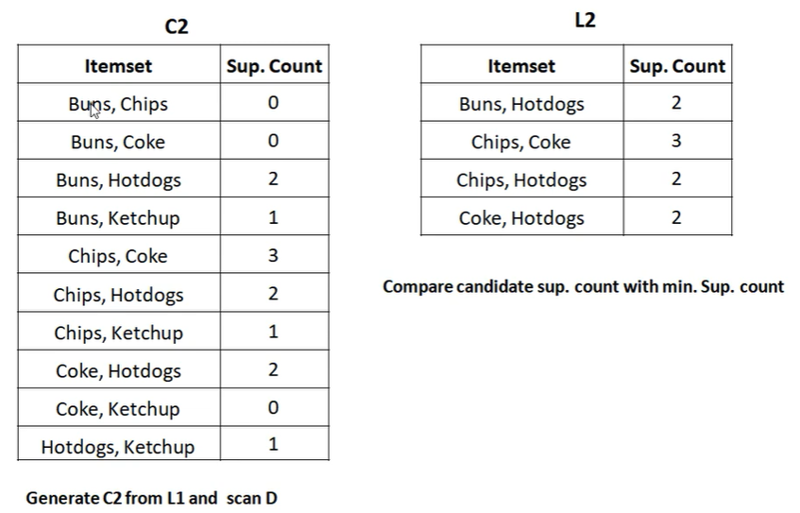
Exercise

Slide 41
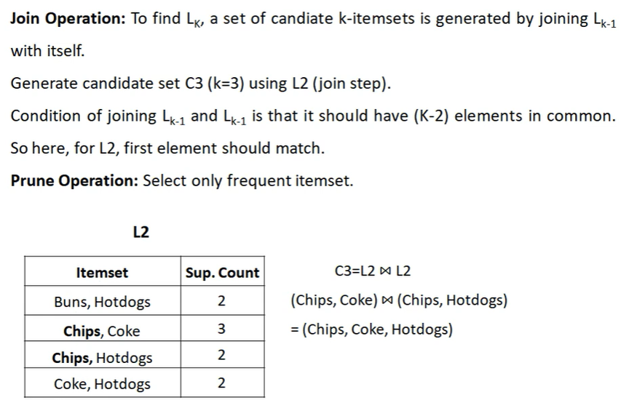




Exercise

Slide 42
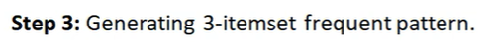
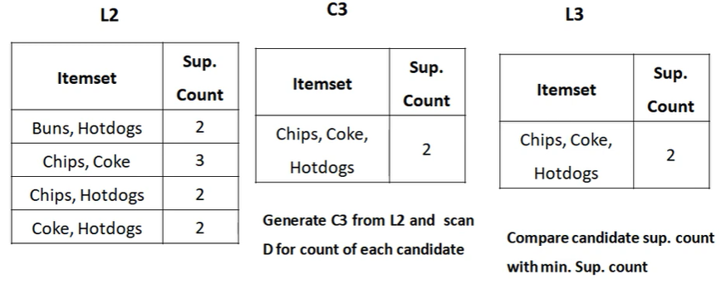




Exercise
C4=NULL, Hence L4=NULL

Slide 43
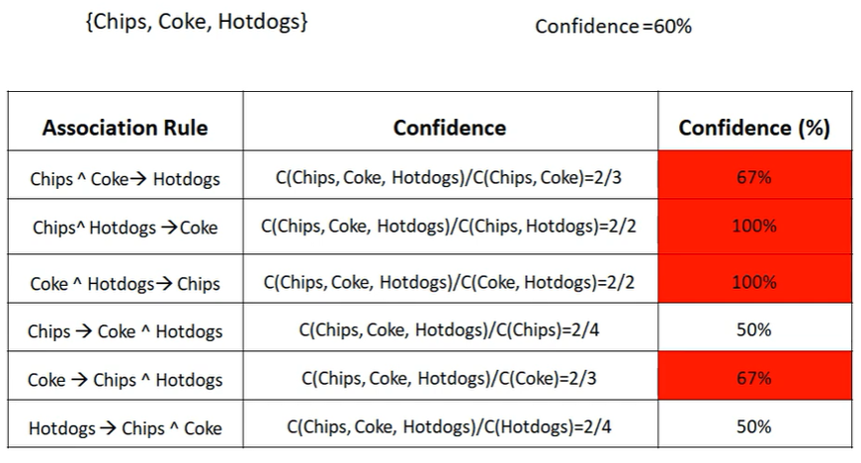


Exercise

Slide 44
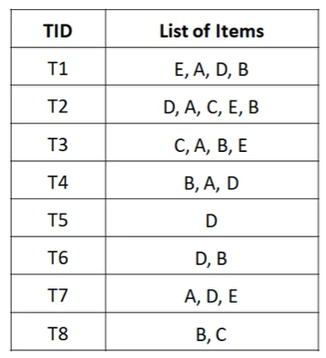
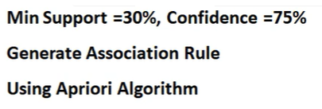
Exercise 2
min Sup=3

Slide 45

Exercise 2

Slide 46

Exercise 2

Slide 47







Exercise 2

Slide 48


Exercise 2

Slide 49




Exercise 2

Slide 50




Exercise 2
D

Slide 51

Apriori Algorithm

Slide 52

Improving Efficiency of Apriori Algorithm

Slide 53

Improving Efficiency of Apriori Algorithm

Slide 54
Improving Efficiency of Apriori Algorithm: Hash Based Technique (hashing itemsets into corresponding buckets)
A hash-based technique can be used to reduce the size of the candidate k-itemsets, Ck, for k > 1.
For example, when scanning each transaction in the database to generate the frequent 1-itemsets (L1), we can do following:
Generate all the 2-itemsets for each transaction,
Hash (i.e., map) them into the different buckets of a hash table structure, and
Increase the corresponding bucket counts.
A 2-itemset with a corresponding bucket count in the hash table that is below the support threshold cannot be frequent and thus should
be removed from the candidate set. Such a hash-based technique may substantially reduce the number of candidate k-itemsets examined (especially when k = 2).

Slide 55

Improving Efficiency of Apriori Algorithm: Hash Based Technique

Slide 56


Improving Efficiency of Apriori Algorithm

Slide 57
While scanning each transaction in the dataset to get support count for each of 1-itemset ,generate 2-itemsets for each transaction, Map each of candidate 2-itemset using hash function to a bucket.
Increment bucket count each time you add an itemset in it.
Finally the itemsets with bucket count < min_suport threshold can not be frequent.

Slide 58

Improving Efficiency of Apriori Algorithm: Transaction Reduction (reducing the number of transactions scanned in future iterations)

Slide 59

Improving Efficiency of Apriori Algorithm: Transaction Reduction
This method reduces no of transaction scans.

Slide 60
sum of each row and column should be >= min _supp.
If < min_supp, then remove that row or column.

Slide 61
Improving Efficiency of Apriori Algorithm: Partitioning (partitioning the data to find candidate itemsets)
A partitioning technique can be used that requires just two database scans to mine the frequent itemsets.
It consists of two phases. In phase I, the algorithm divides the transactions of dataset D into n non-overlapping partitions.
If the minimum relative support threshold for transactions in D is min_ sup, then the minimum support count for a partition is
min_sup x the number of transactions in that partition.
For each partition, all the local frequent itemsets (i.e., the itemsets frequent within the partition) are found.
A local frequent itemset may or may not be frequent with respect to the entire database, D. However, any itemset that is potentially frequent with respect to D must occur as a frequent itemset in at least one of the partitions. Therefore, all local frequent itemsets are candidate itemsets with respect to D.
The collection of frequent itemsets from all partitions forms the global candidate itemsets with respect to D.
In phase II,a second scan of D is conducted in which the actual support of each candidate is assessed to determine the global frequent itemsets.
Partition size and the number of partitions are set so that each partition can fit into main memory and therefore be read only once in each phase.

Slide 62

Improving Efficiency of Apriori Algorithm: Partitioning (partitioning the data to find candidate itemsets)

Slide 63

Improving Efficiency of Apriori Algorithm

Slide 64

Improving Efficiency of Apriori Algorithm: Partitioning

Slide 65
2 phases:
Phase 1:
Partition the dataset into n non overlapping partitions.
For each partition consider all possible itemsets .
During first scan of the dataset,find count for each itemsets (1,2,3….) in each partition.
Then take union of itemsets in each partition to get candidate set for phase 2.
Phase 2:
Scan the dataset to get count for each of the candidate itemset.
If count of itemset<min_supp , then it is not a frequent itemset.

Slide 66
Improving Efficiency of Apriori Algorithm:
Dynamic Itemset Counting (adding candidate itemsets at different points during a scan)
A dynamic itemset counting technique was proposed in which the database is partitioned into blocks marked by start points.
In this variation, new candidate itemsets can be added at any start point, unlike in Apriori, which determines new candidate itemsets only immediately before each complete database scan.
The technique uses the count-so-far as the lower bound of the actual count.
If the count-so-far passes the minimum support, the itemset is added into the frequent itemset collection and can be used to generate longer candidates. This leads to fewer database scans thanwith Apriori for finding all the frequent itemsets

Slide 67

Improving Efficiency of Apriori Algorithm:

Slide 68

Improving Efficiency of Apriori Algorithm:DIC

Slide 69

DIC Algorithm

Slide 70
Improving Efficiency of Apriori Algorithm:DIC
Itemsets are marked in 4 different ways as they are counted.

Slide 71



Improving Efficiency of Apriori Algorithm:DIC

Slide 72




Improving Efficiency of Apriori Algorithm:DIC
https://www.youtube.com/watch?v=SLhLJZK6KaE

Slide 73
Improving Efficiency of Apriori Algorithm: Sampling
(mining on a subset of the given data)
The fundamental idea of the sampling approach is to select a random sample S of the given data D, and then search for frequent itemsets in S rather than D.
It may be possible to lose the global frequent itemset. This can be reduced by lowering the minimum support.
The sample size of S is such that the search for frequent itemsets in S can be completed in main memory, and therefore only one scan of the transactions in S is needed overall.
Because we are searching for frequent itemsets in S rather than in D, it is possible that we will miss some of the global frequent itemsets

Slide 74




Applications Of Apriori Algorithm
Improved store layout
Cross marketing
Focused attached mailings / add-on sales
Maintenance Agreement (What the store should do to boost Maintenance Agreement sales)
Home Electronics (What other products should the store stock up?)
Pharmacy to find frequent medicine itemsets
For Student's Trends Analysis

Slide 75
Application of Apriori Algorithm in the Real World
1. Education Field
As we all know that all the students studying in the school have different characteristics and personalities like every student are different in age, gender, different names, and different parents' names, etc.
2. Medical Field
In every hospital, there are a lot of patients admitted over there every patient have a different kind of disease according to which they are given a different treatment, and they all will have a different type of characteristics and different medical history, so here it is necessary to use the computer science method of Apriori algorithm in order analyze the patients' database. So that there should be no mixing of the information of different patients
3. Forestry
In every forest, there are several kinds of flora and fauna. And, naturally, there are a variety of trees which are having different features like their sizes, texture, seasons of trees, etc. similarly, there are various types of animals having a variety of features, which makes them different from one another. So to analyze all such details, we use the method of the Apriori algorithm.

Slide 76
4. New Technology Business Firms
Apriori is used by many companies like Flipkart, Amazon, etc. where they have to maintain the record of various items of products that are purchased by various customers for recommender systems and by google for the autocomplete features.
5. Offices
One of the most efficient uses of this computer science technique is in the offices where they have to record a large number of day to day transactions related to sale and purchase of various good and services, like recording the transactions of creditors, sales and purchases so there is need of analysis of all such transactions so that there should not be any kind of confusion.
6. Mobile e-Commerce
The main purpose of using this technique is to make mobile e-commerce shopping easy, convenient, and increase the customer base crossing national and international borders. The deployment of the unity of real-time and recommendation accuracy is made so that mobile e-commerce gets the maximum benefit of the Apriori algorithm.

Slide 77



Applications Of Apriori Algorithm
Some fields where Apriori is used:
In Education Field: Extracting association rules in data mining of admitted students through characteristics and specialties.
In the Medical field: For example Analysis of the patient’s database.
In Forestry: Analysis of probability and intensity of forest fire with the forest fire data.
Apriori is used by many companies like Amazon in the Recommender System and by Google for the auto-complete feature.

Slide 78

FP (Frequent Pattern Growth Algorithm)

Slide 79

FP (Frequent Pattern Growth Algorithm)

Slide 80

Example 1

Slide 81




FP (Frequent Pattern Growth Algorithm)

Slide 82



FP (Frequent Pattern Growth Algorithm)
i. e Find Frequent itemsets
Frequent Itemsets
1: highest priority

Slide 83


FP (Frequent Pattern Growth Algorithm)
i.e find the Ordered Itemsets
Here ,for each transaction, arrange the items in the descending order of their priority
Ordered Itemsets

Slide 84




FP (Frequent Pattern Growth Algorithm)
Insert all ordered itemsets into a Trie data structure
Start with NULL node and for every transaction’s ordered Itemset, create a path.

Slide 85


FP (Frequent Pattern Growth Algorithm)

Slide 86

Step 6: Compute Conditional pattern base(CPB) for each item : It is apath labels of all the paths which lead to any node of the given item in the FP tree.
Item | Conditional Pattern Base(Path to reach item)
F | {{D,A:1},{D,E,A,B:1,{D,E,B:1}}
B | {{D,E,A:1},{D,E:2}}
A | {{D:1},{D,E:2}}
E | {D:4}
D | —

Slide 87
Step 7: Build Conditional FP Tree for each item.
For this, take the set of elements which is common in all the paths in the conditional pattern base for that item and calculate the support count by summing the support counts of all the paths in the conditional pattern base.
Item | Conditional Pattern Base(Path to reach item) | Conditional Frequent Pattern Tree
F | {{D,A:1},{D,E,A,B:1,{D,E,B:1}} | {D:3}
B | {{D,E,A:1},{D,E:2}} | {D,E:3}
A | {{D:1},{D,E:2}} | {D:3}
E | {D:4} | {D:4}
D | — | —-

Slide 88
Step 8: Generate Frequent Patterns
Generate frequent pattern rules by pairing the items of conditional frequent pattern tree set to the corresponding item as shown below.
Item | Conditional Pattern Base(Path to reach item) | Conditional Frequent Pattern Tree
F | {{D,A:1},{D,E,A,B:1,{D,E,B:1}} | {D:3}
B | {{D,E,A:1},{D,E:2}} | {D,E:3}
A | {{D:1},{D,E:2}} | {D:3}
E | {D:4} | {D:4}
D | — | —-
Item | Frequent Pattern Generated
F | {<D,F: 3>}
B | {<D,B:3>, <E,B:3>,<D,E,B:3>}
A | {<D,A:3>}
E | {<D,E:4>}
D | —

Slide 89
Step 8: Write frequent pattern Rules
The rules that satisfy minimum confidence threshold ae strong association rules .

Slide 90



Example 2

Slide 91




Slide 92

Ordered Itemsets

Slide 93




Slide 94


Slide 95


Slide 96



Slide 97
Step 6: Compute Conditional pattern base(CPB) for each item : It is apath labels of all the paths which lead to any node of the given item in the FP tree.
Item | Conditional Pattern Base(Path to reach item)
C | {{B,D,A,E:1},{B,A,,E:1},{B:1}}
E | {{D,A:1},{B,D,A:2},{B,A:1}}
A | {{D:1},{B,D:3},{B:1},}
D | {B:4}
B | —

Slide 98
Step 7: Build Conditional FP Tree for each item.
For this, take the set of elements which is common in all the paths in the conditional pattern base for that item and calculate the support count by summing the support counts of all the paths in the conditional pattern base.
Item | Conditional Pattern Base(Path to reach item) | Conditional Frequent Pattern Tree
C | {{B,D,A,E:1},{B,A,,E:1},{B:1}} | {B:3}
E | {{D,A:1},{B,D,A:2},{B,A:1}} | {A:4}
A | {{D:1},{B,D:3},{B:1},} | —
D | {B:4} | {B:4}
B | — | —-

Slide 99
Step 8: Generate Frequent Patterns
Generate frequent pattern rules by pairing the items of conditional frequent pattern tree set to the corresponding item as shown below.
Item | Conditional Pattern Base(Path to reach item) | Conditional Frequent Pattern Tree
C | {{B,D,A,E:1},{B,A,,E:1},{B:1}} | {B:3}
E | {{D,A:1},{B,D,A:2},{B,A:1}} | {A:4}
A | {{D:1},{B,D:3},{B:1},} | —
D | {B:4} | {B:4}
B | — | —-
Item | Frequent Pattern Generated
C | {<B,C: 3>}
E | {<A,E:4>
A | —-
D | {<B:4>}
B | —

Slide 100
Step 8: Write frequent pattern Rules
The rules that satisfy minimum confidence threshold ae strong association rules .

Slide 101
Example 3
https://www.youtube.com/watch?v=kK6yRznGTdo

Slide 102

ECLAT(Equivalence Class Transformation) Vertical Apriori

Slide 103

ECLAT-Example 1

Slide 104


Slide 105


Slide 106


Slide 107


Slide 108



Slide 109
ECLAT - Example 2
https://www.youtube.com/watch?v=P5LH5HCrhMU

Slide 110





Slide 111

Single Dimensional Association Rules

Slide 112


Multidimensional Association Rules

Slide 113

Hybrid Association Rules

